Slide 1
Probability Basics, Conditional Probability and Bays Theorem
What is probability?
Probability Concepts
Types of Probability
Conditional Probability
Bay’s Theorem

Slide 2
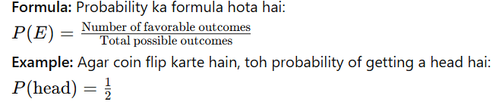
What is Probability?
tells us how likely something is to happen, and in ML, it helps to make decisions based on uncertain data.
In Machine Learning, probability is crucial because we often deal with uncertain outcomes, whether we’re predicting the next word in a sentence or classifying an image.
Probability ek mathematical concept hai jo kisi event ke hone ke chance ko measure karta hai.
Example: Agar aap ek coin uchhalte hain, toh probability yeh hai ke woh head ya tail banega.

Slide 3
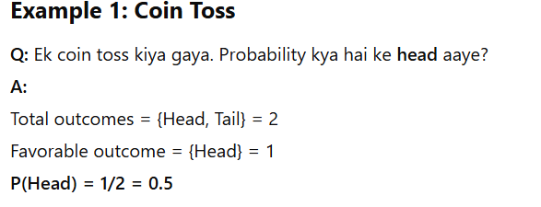
Examples

Slide 4
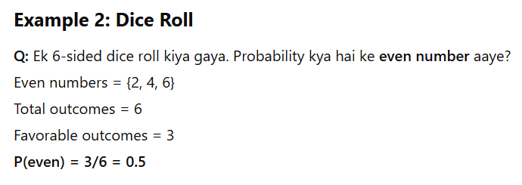
Examples

Slide 5
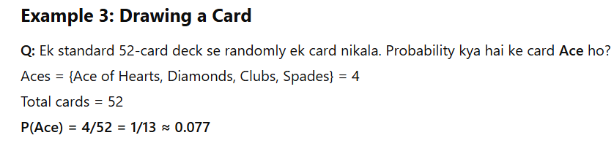
Examples

Slide 6
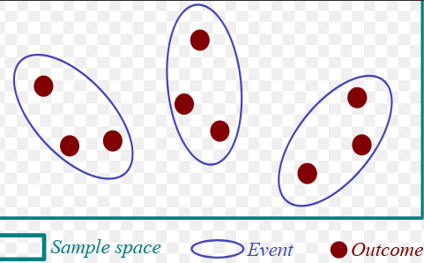
2 Basic Concepts of Probability:
2.1 Sample Space (S):
Sample Space woh set hota hai jo saare possible outcomes ko represent karta hai.
Example: Agar aap dice roll kar rahe hain, toh sample space hoga: S={1,2,3,4,5,6} Yani dice ke roll karne pe aap 1 se le kar 6 tak koi bhi number paa sakte hain.
2.2 Event (E):
Event ek specific outcome ya group of outcomes hota hai jo aap predict kar rahe hote hain.
Example: Agar aap chahte hain ke dice pe 4 aaye, toh E = {4} hoga. Matlab aap event ko define kar rahe hain jo 4 ke outcome ko represent karta hai.

Slide 7
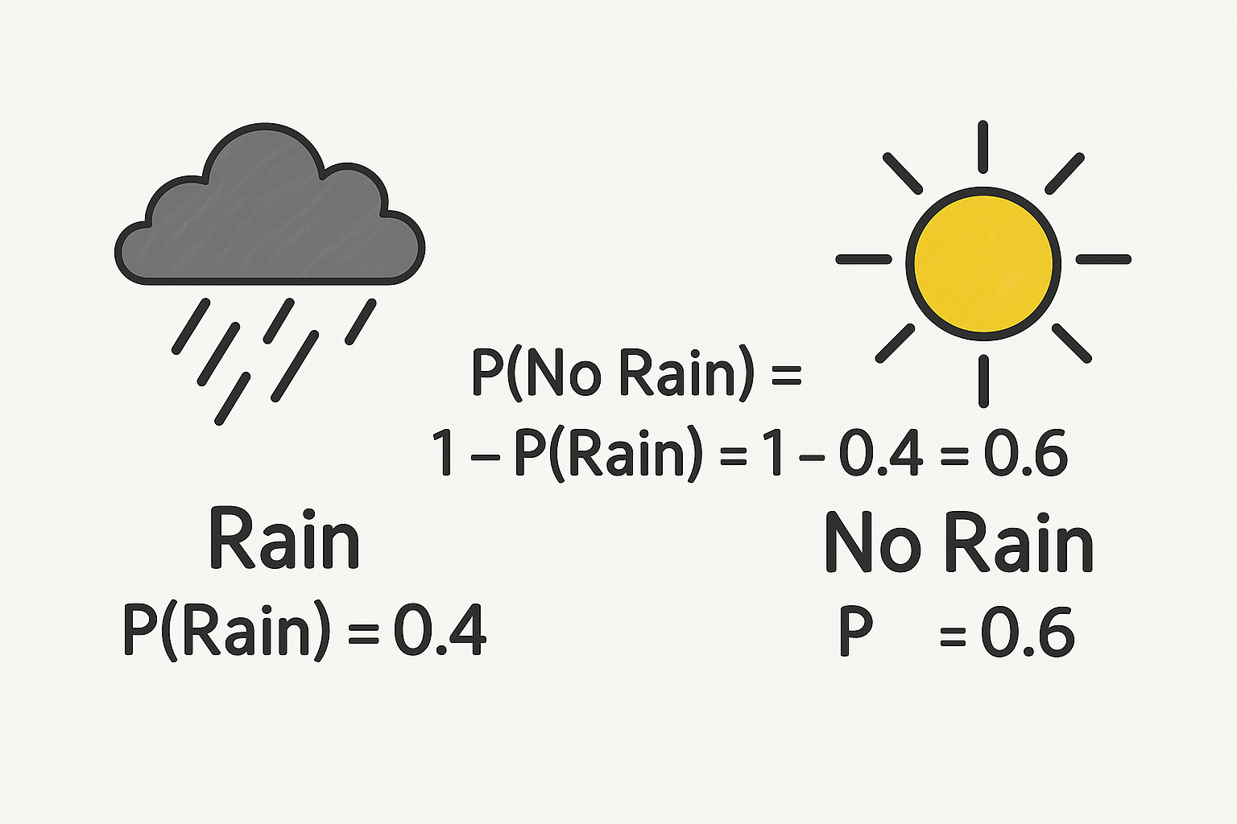
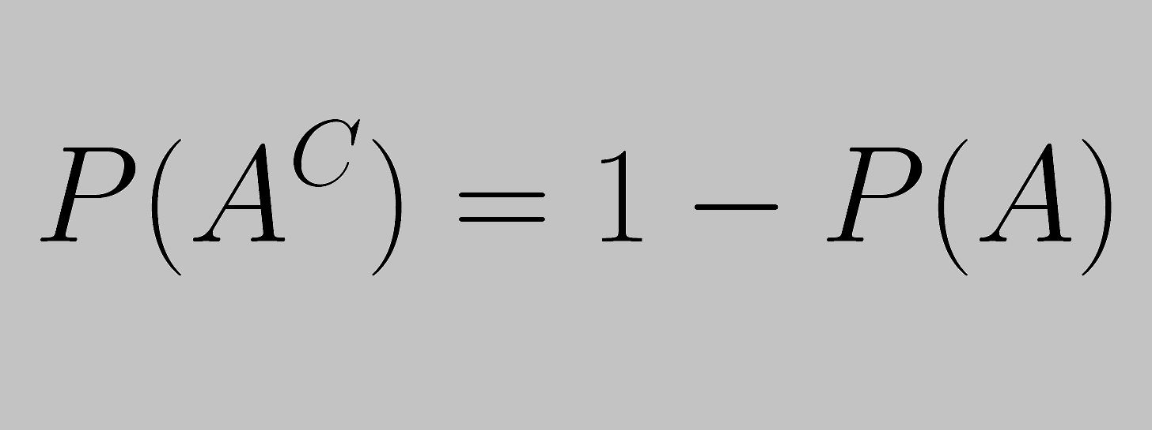
3. Types of Events
3.1 Complementary Events:
Complementary events wo events hote hain jo ek dusre ke opposite hote hain.
Example: Agar event E "rain" ka hai, toh complementary event hoga "no rain".
Agar P(rain) = 0.4, toh P(no rain) = 1 - 0.4 = 0.6 Yani agar ek cheez hone ki probability hai, toh doosri cheez hone ki probability 1 se uski probability minus karne pe milti hai.

Slide 8
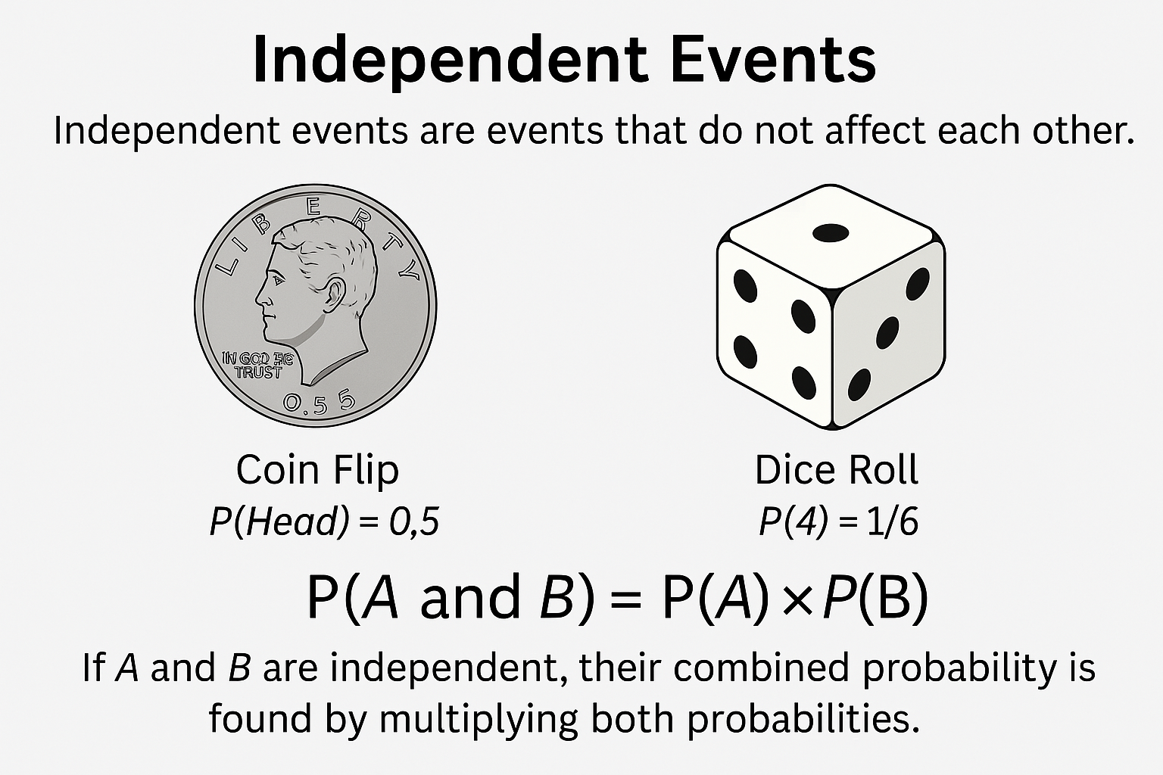
3. Types of Events
3.2 Independent Events:
Independent events wo events hote hain jo ek dusre se affect nahi hote.
Example: Agar aap ek coin flip kar rahe hain aur dice roll kar rahe hain, toh dono events independent hain, kyunki ek ka dusre par koi asar nahi hai.

Slide 9
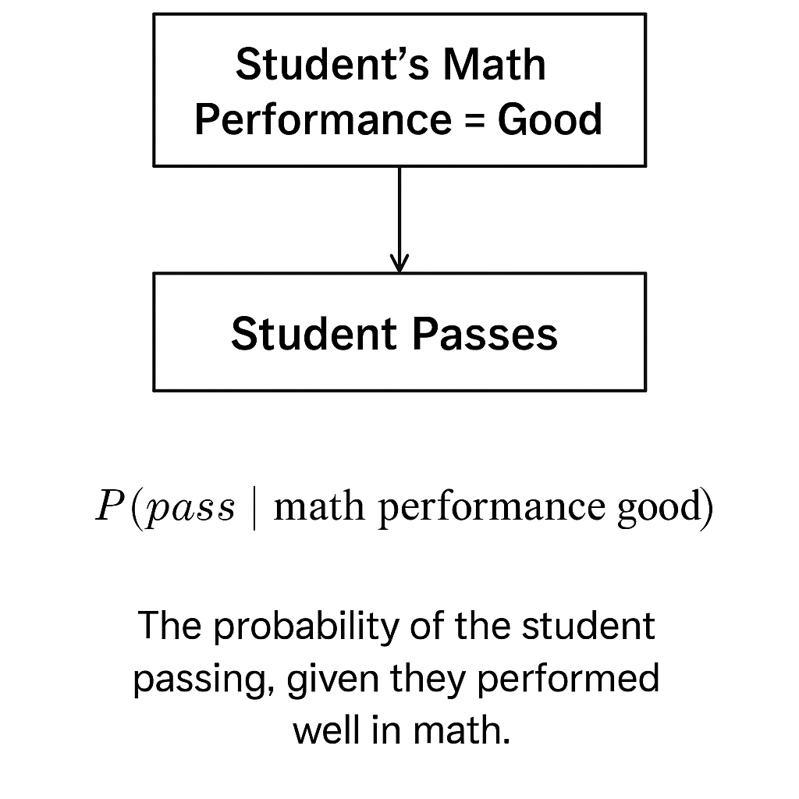
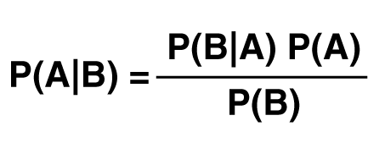
4. Conditional Probability:
4.1 What is Conditional Probability?
Conditional Probability us probability ko kehte hain jo ek event ke hone ke baad doosre event ke hone ka chance batata hai.
Example: Agar aapko yeh jaanna ho ke ek student pass hua hai, aur aapko already pata hai ki usne math ke paper mein accha perform kiya, toh yeh conditional probability hogi.
P(pass | math performance good): Yeh batata hai ki math ke achhe performance ke condition mein pass hone ka chance kitna hai.

Slide 10
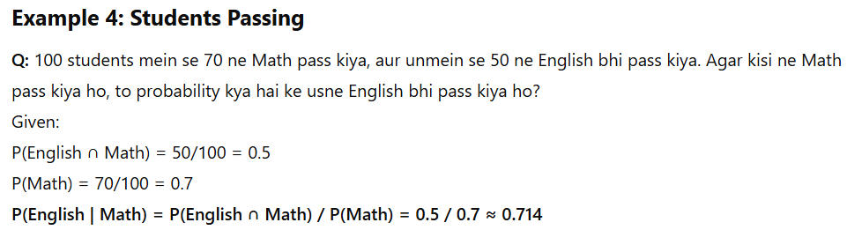
4. Conditional Probability:

Slide 11
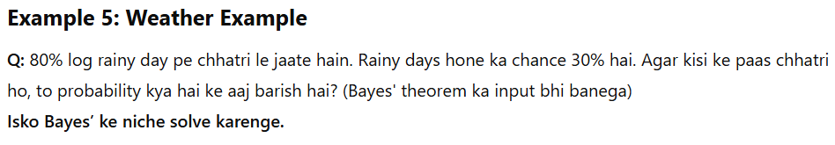
4. Conditional Probability:

Slide 12
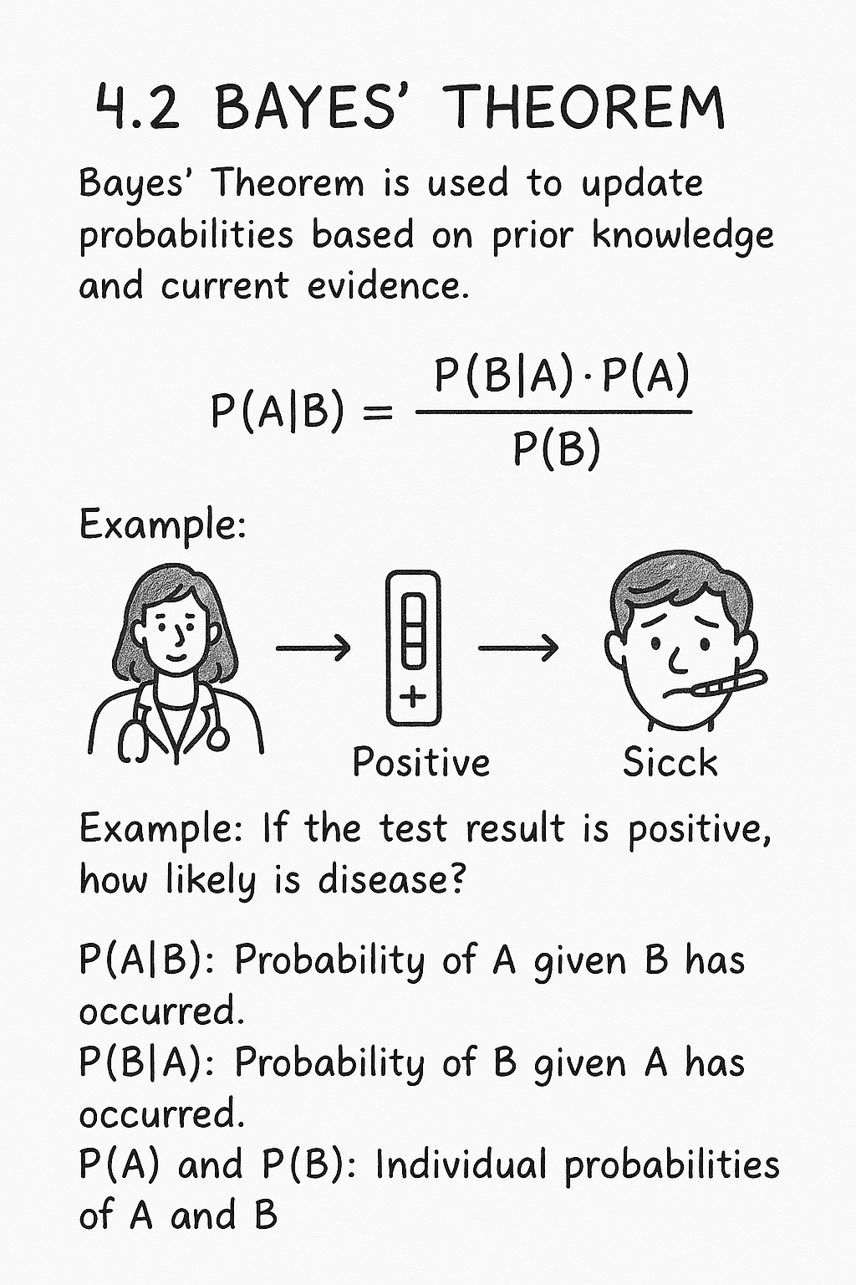
Bays Theorem
Bayes' Theorem conditional probability ka ek important concept hai. Yeh theorem previous knowledge aur current data ke basis par probability ko update karta hai.

Slide 13
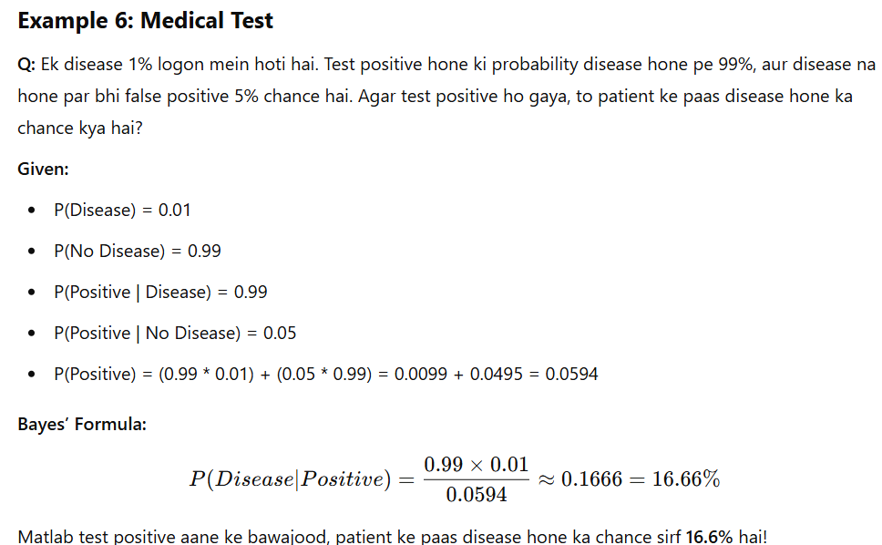
Examples

Slide 14
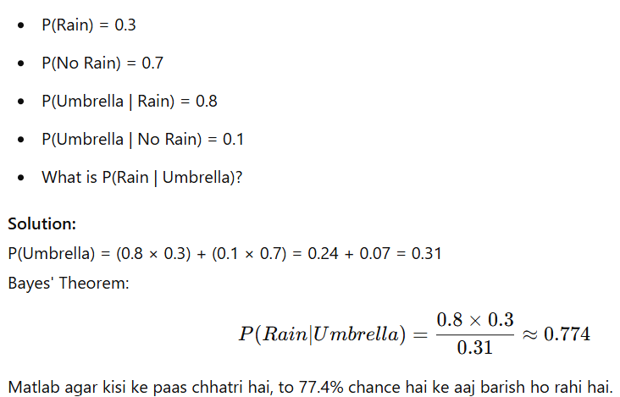
Examples

